Slide 1
Artificial Intelligence in Finance
Eli Clizbe, Drew Gandham,
Andrew McGrady, Will Michael
Notes:
-For our project, we were tasked with going through a lot of different JP Morgan AI IN FINANCE Papers and we thought it would be useful to broaden our scope for this class and talk about something that we found really interesting about AI In finance. Some of the papers were extremely in the weeds and we thought it’d be fun to choose a paper that took more of a broad approach to what JP Morgan is doing with AI in Finance… Also, it turns out this paper was headed by a woman on the William and Mary advisory board

Slide 2
What is AI? How does it relate to finance?
AI - a science, engineering discipline
Significant amount/diversity of data
Global banks and equity exchanges
Driven by information sources
Notes:
Artificial Intelligence - a science, engineering discipline - highly relevant to financial services
First, there is a significant amount and diversity of data generated and consumed worldwide
Global banks process billions of international payments each day and equity exchanges handle trillions of orders and billions of transactions
All of this activity is recorded as data, and this data is driven by different information sources such as news and social media

Slide 3
Challenges and Goals of AI in Finance
Foundational:
1: Eradicate Financial Crime
2: Liberate Data Safely
3: Predict and Affect Economic Systems
Stakeholder Engagement:
4: Perfect the Client Experience
5: Empower the Employee
6: Enhance Policy Compliance
Cross Cutting:
7: Establish Ethically and Socially Good AI
Notes:
Foundational:
1: Eradicate Financial Crime - AI can be leveraged to detect and eliminate financial crime
For example-understanding using game theory simulation or using behaviour mining, analysis, and simulation
2: Liberate Data Safely - AI can support and enable secure information sharing while preventing leaking sensitive information
For example- helping label data so it’s useful to researchers and machine learning (ML) algorithms
3: Predict and Affect Economic Systems - AI can help us understand and model the many participants in complex economic systems
For example-provide algorithms to predict potential future states of economic systems, including uncertainty estimates
Stakeholder Engagement:
4: Perfect the Client Experience
For example - AI can enhance the ability to discover potential clients and streamline the process of ‘onboarding’ new clients
5: Empower the Employee
For example - AI can empower employees by automating cognitive tasks and enhancing employee experience and job role/fit
6: Enhance Policy Compliance - AI can help address a number of challenges related to obligations to comply with laws, regulations, and policies
For example - create mechanisms that enable automatic updates to monitoring systems.
Cross Cutting:
7: Establish Ethically and Socially Good AI
For example - improving existing ethically and socially good models and ensuring software is able to detect and mitigate bias in systems

Slide 4
Emerging Techniques
Agent-based View
Multi-agent Simulation
Synthesizing Data
Transformation of Representation
Graphical Models
Reducing data siloing
Analysis of Fairness, Ethics, and Bias in AI
Notes:
-Eli

Slide 5
Synthetic Data for Finance
Produces large amounts of realistic, synthetic data
Uses multi-agent simulation for more realistic aggregate action
Allows anonymity, not touching real data
Useful for cloud computing security, class balancing,
Notes:
-Eli

Slide 6
Computer Vision for Time-Series Forecasting
Uses visualizations instead of numeric data
Provides predicted visualizations
Notes:
-Drew

Slide 7
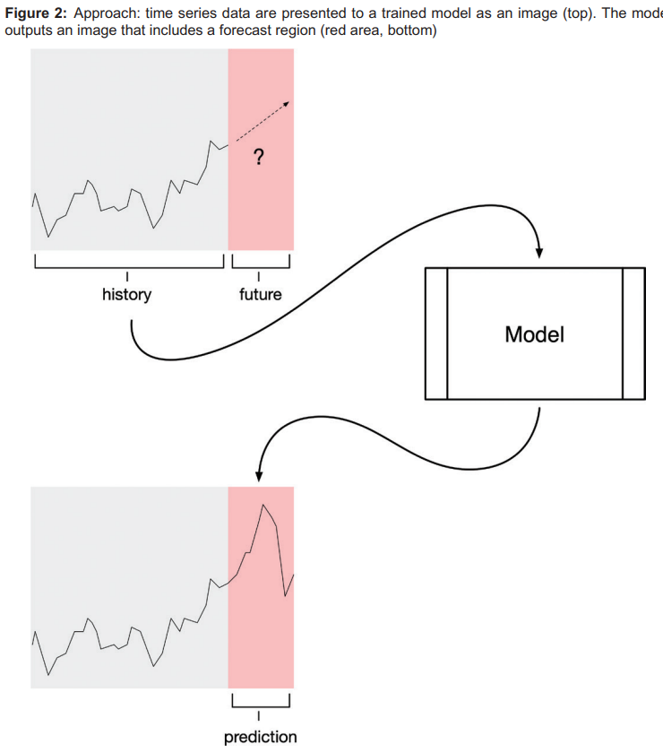
Computer Vision (“VisualAE”) Procedure

Slide 8
Learning Document Generation Requests
Voice-activated, natural language
Generate basic documents and visualizations
Also include “insights” or commentary for visualizations
48% of employees’ time spent creating or updating reports
Notes:
-Drew

Slide 9
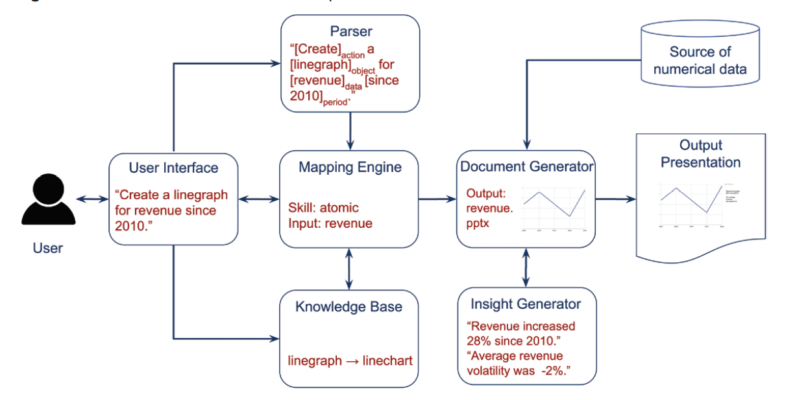
DocuBot Procedure

Slide 10
Exercise Walkthrough: 12-10

Slide 11
Works Cited

